Slide 1
Kiwanis International
Youth Protection
Policies in Practice
Presented by Melissa McMann, Youth Protection Specialist
October 2021

Slide 2
Why Youth Protection Matters

Slide 3




Why Youth Protection Matters
Through KYP, Kiwanis serves over 300,000 youth each year
During childhood across all ages and socioeconomic levels:
      1 in 4 Girls
      1 in 13 Boys
      experience child sexual abuse
Notes:
Adolescent girls are at the highest risk, with many female adults reporting that their victimization first occurred before the age of 18…
source: ”Preventing CSA in YSOs” www.CDC/violenceprevention

Slide 4

Why Youth Protection Matters
Abusers have in common:
  Privacy
  Access
  Control
Abuse is usually at the hands of a known acquaintances and family member NOT strangers
    More than 90% of abusers are people children know, love and trust
    85% of child abuse victims never report their abuse

Slide 5
Why Youth Protection Matters
Suicide is the 2nd leading cause of death in children and adolescents in the US
Suicide is the 2nd leading cause of death in 15-29 age group globally
Risk factors
  exposure to violence
  impulsivity
  aggressive or disruptive behavior
  access to firearms
  bullying
  feelings of hopelessness or helplessness
  acute loss or rejection
Notes:
Experiencing CSA can result in short- and long-term physical, mental, and emotional health consequences like posttraumatic stress disorder symptoms, and substance use.
Social distancing can be especially hard for teens, who may feel cut off from their friends. Many also face big letdowns as graduations, proms, sports seasons, college visits and other long-planned events are cancelled or postponed
*to educate parents and teachers to recognize depression in young people and to learn about the warning signs of suicide — like a sudden change in behavior, talking or writing about suicide, and giving away prized possessions.
*We want need to do a better job of identifying, reaching out to and providing resources for at-risk youths. To Identify those who are suffering from depression and who are at risk of suicide.

Slide 6

Kiwanis Student & Youth Protection Goals
Protect, educate and engage all Kiwanis members youth and adult.
Protect youth members from predators
Empower and educate adult members with best practices when working with youth
Provide youth with positive skills development tools designed to inspire and engage our future leaders to be their best
This Photo by Unknown Author is licensed under CC BY-SA
Notes:
Remember your commitment to keeping those youth in your care safe.
We are growing the next generation of service leaders. We can help them develop their ability to empathize with those in need in their community.

Slide 7
Youth Protection ABCs
A – Accessible, high quality training and resources
B – Background Checks and Beyond
C – Culture of Care
Notes:
Kiwanis takes a multi-faceted approach to protecting youth members of Service Leadership Programs and the youth served in our communities. As a high standard service leadership organization, Kiwanis continues to review, expand, and enhance our youth protection practices.
A = Access to high quality training and resources for Kiwanis adult and youth members, chaperones, and leaders.
B = Background checks and Beyond
C = Culture of care for our youth/student members of SLP clubs.

Slide 8
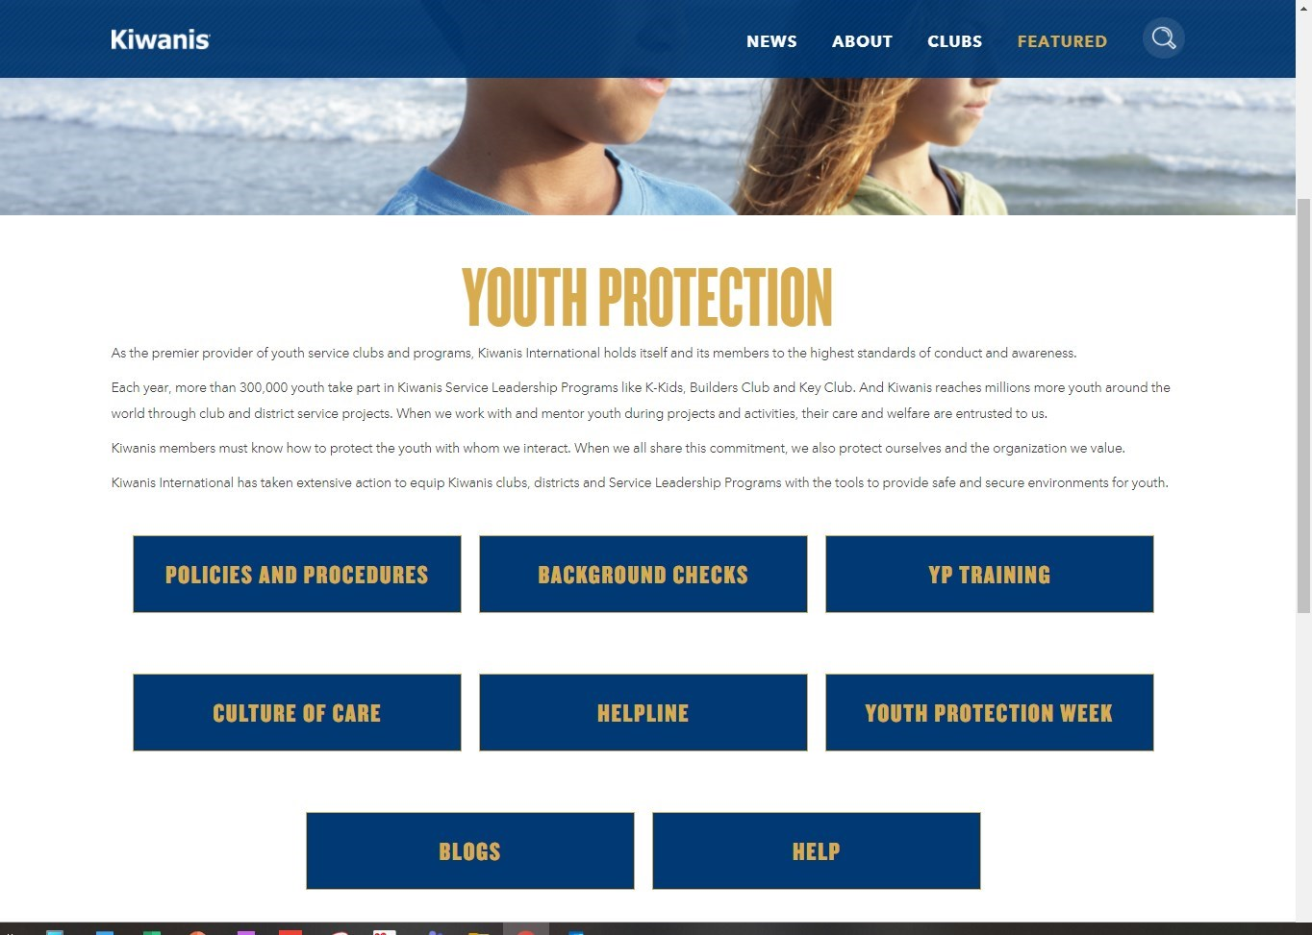
Go to Kiwanis.org/youth protection
Notes:
Access YP Policies and Procedures document on YP page.
Access YP Training resources by clicking button. We will continue to build out resources. Club leaders can use our ppt training slides to present or ask your District’s Youth Protection Manager to provide training to your club in-person or virtually. I’m also available to present YP training at your local club.

Slide 9
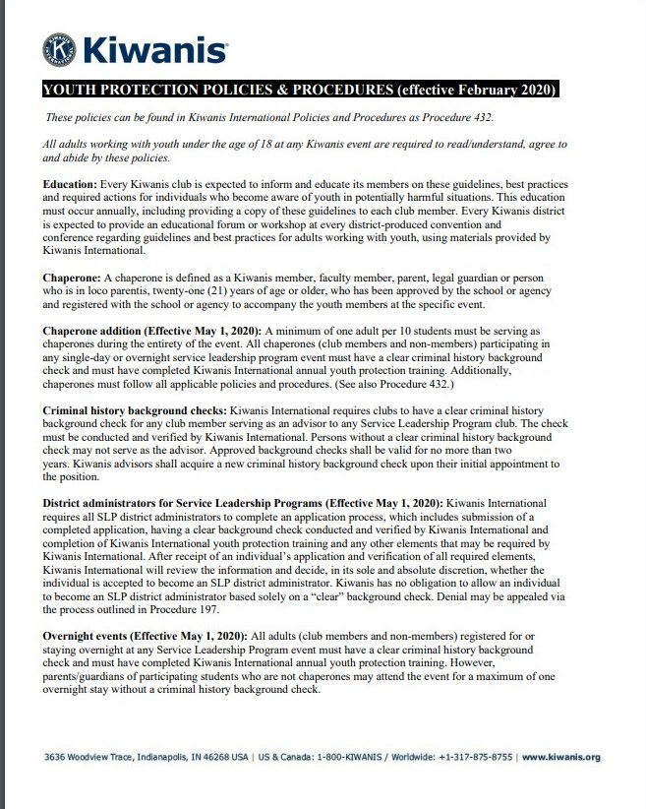
A- Accessible Training
YP Policy Training
Education
Every Kiwanis club is expected to inform and educate its members on these guidelines, best practices and required actions for individuals who become aware of youth in potentially harmful situations
Districts will have forums or workshops at conventions and conferences.
Club Leadership Education for YPG is currently unavailable in Kiwanis Connect. Training slides will be on:
  Kiwanis.org/youthprotection website
Notes:
Here is a screen shot of the newest version Youth Protection policies and procedures that include updates that were approved by the Board of Trustees in February 2020.
This 2page document can be found on the Kiwanis.org/ youthprotection webpage as downloadable .pdf.
Every Kiwanis district is expected to provide an educational forum or workshop at every district produced convention/conference regarding guidelines and best practices for adults working with youth.
Invite your district’s Youth Protection Manager to provide the training for your club! Current online meeting format allows for this to be easily managed.

Slide 10
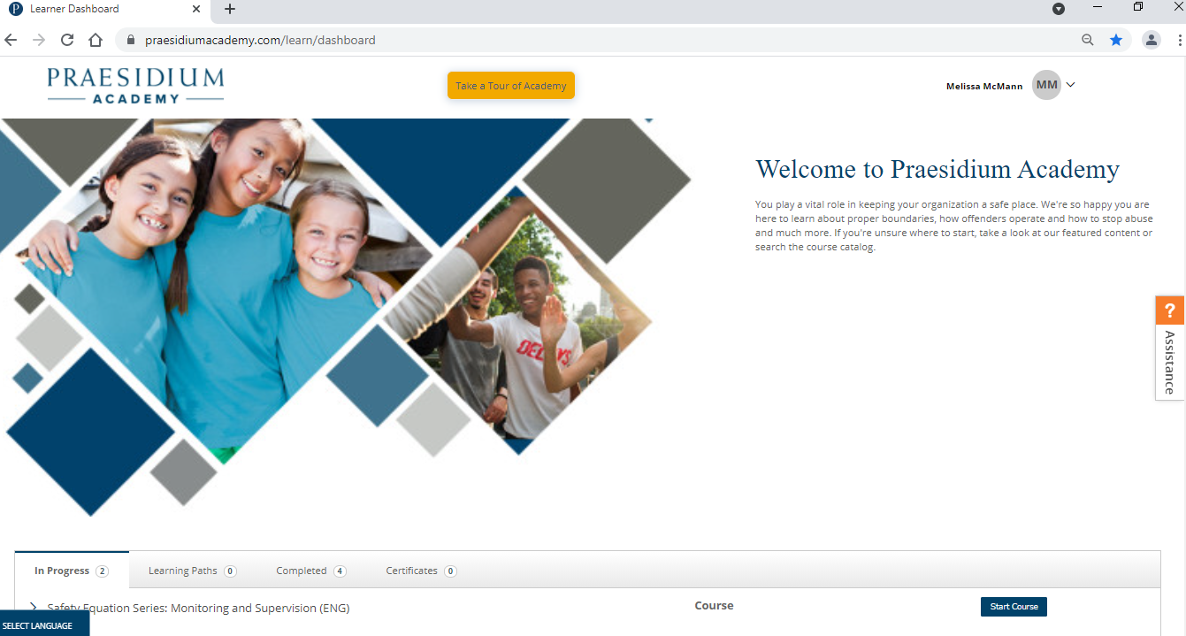
A – Accessible Training
Youth Protection courses
Kiwanis SLP Advisors, District Admins, Risk & Youth Protection managers are required to complete modules assigned to their role.
  Enrolled in system when assigned role.
Chaperones to youth hosted SLP events required to complete ”Chaperone” youth safety training modules.
  Names of chaperones should be emailed to youthprotection@kiwanis.org to be added manually.
Members (club president, secretary, etc.) are not required, but can access all courses.
  Self-initiate by clicking “create Praesidium account” on Kiwanis Connect member page.
Faculty Advisors are not required to completed courses but can be given access.
Youth Protection Courses
Developed by Praesidium, Inc.
*7/2021 Any completed courses migrated from Armatus to Praesidium Academy system
*Password reset needed
Notes:
Praesidium migrated their youth protection courses from Armatus learning management system (LMS) to Praesidium Academy. All completed data was migrated over. Users now need to reset their password using their email on file with KI.

Slide 11

A – Accessible Training
Policy – SLP Advisor Background checks
Background checks for Kiwanis SLP Advisors
Kiwanis International requires clubs to have a clear criminal history background check for any club member serving as an advisor to any Service Leadership Program club (SLP). SLPs include:
    Circle K International
    Key Club
    Builders Club
    K-Kids Club
    Aktion Club
Notes:
Why background checks? Through our research, we know that background checks can be used as a screening tool to identify protentional predators who have a history of violence or child abuse.
While Kiwanis is a global organization, we realize that background checks and the mechanics of receiving those checks vary greatly from country to country.

Slide 12
Policy in Practice
When Faculty Advisors Need Background Check Scenarios
Scenario 1
Faculty advisor only works with students on school premises for meetings and events.
School background check is sufficient. Advisor should have our Kiwanis Youth Protection Policy and adhere to either our standards or schools’ standards of conduct, whichever policy has the stricter guidance.
Scenario 2
Faculty advisor works with students on school premises and attends events outside of the normal school activities such as overnights with students.
Faculty advisor will be required to have an approved background check through the Kiwanis vendor for any and all overnight stays. They will be required to take our chaperone training via Praesidium Inc. and annually review our Youth Protection Policies.

Slide 13

A – Accessible Training
Chaperone Policy for Youth Programs
Must be 21 years old or older. (*Some districts require an older age.)
All chaperones (club members and non-members) participating in any single-day event off school premises or overnight Service Leadership Program sponsored event must have a clear background check;
Must have completed Kiwanis International annual youth protection training.
Must follow all applicable Youth Protection policies and procedures.
A minimum of one adult per 10 students must be serving as chaperones during the entirety of the event.
Notes:
The policy was updated Feb. 2020 to add all chaperones are required to have background check if participating in in overnight or off school grounds event. Previously, it was left up to the District to decide. More and more districts began requiring chaperones to complete background checks so we took that under advisement.

Slide 14

A – Accessible Training
Overnight Chaperone Policy
Each overnight Kiwanis sponsored youth event must have a minimum 1 chaperone per 10 students.
    Adult chaperones must include 1 adult male for each 10 youth males or part of 10 youth males AND 1 adult female for each 10 youth females or part of 10 youth females.
    Adults MAY NOT share sleeping quarters with students unless it is their child or in a bunkhouse/camp cabin setting.

Slide 15





A – Accessible Training
Social Media & Communication Policy
Best bet: connect via a club page/account and not individual youth member accounts.
Never initiate following, friending, or liking posts and pages of individual students.
Treat all social posts and interactions as public facing.
Never post pictures of youth on your personal social media pages,
Follow the Rule of 3, always include parents/guardians or another adult (Kiwanis or Faculty Advisor, DA, or District YP Manager).
  Avoid 1:1 texts
  Avoid1:1 emails

Slide 16

YP Policy & Practice
Safe Virtual SLP Club Meetings
We advise programs to have at least 2-3 background checked adults (advisors or chaperones, etc.) participate in virtual programs, whether these are with small or large groups.
Regardless if you have 30 youth or 5 youth, the recommendation would be to have at least 2 adults if possible.
Having at least 2-3 adults discourages any inappropriate one-on-one engagement and can help hold the student members and the other advisors/chaperones accountable to the code of conduct or any other program guidelines.
Notes:
A short training video on “How to hold safe, online meetings for SLP clubs” can also be found on the Kiwanis International Youth Protection /YP training web page.

Slide 17
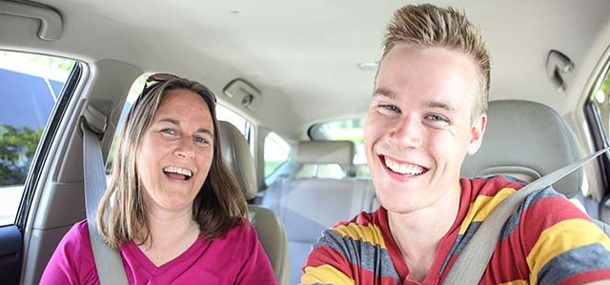

YP Policy & Practice
Transportation Best Practices
At least three people in a car
Student(s) ride in the back seat/rows
Approval required from parents/guardian
Follow local school/local law policy
This Photo by Unknown Author is licensed under CC BY-NC-ND

Slide 18


A – Accessible Training
YP Policy
Medication
Possession of prescription and non-prescription medications should only be allowed with written permission from parent or guardian.

Slide 19
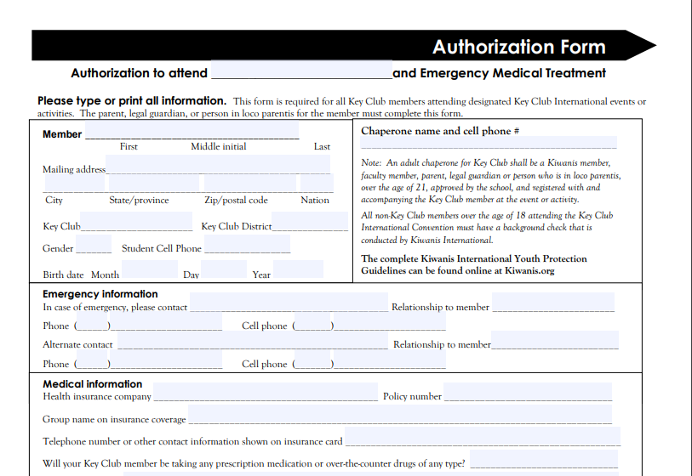
A – Accessible Training
YP Policy
Medication

Slide 20
A – Accessible Training
YP Policy
Reporting guidelines:
If a Kiwanian observes troubling behavior involving a youth at a Kiwanis event or becomes aware of a situation that is illegal or potentially unsafe for a young person at a Kiwanis event, the Kiwanian must immediately:
      Contact the appropriate personnel on-site.
      Provide notification to law enforcement personnel as appropriate.
If the Kiwanian becomes aware of the troubling behavior after the event, they must:
  Contact leaders of the event.
  Provide notification to law enforcement personnel as appropriate.
  All local, state, provincial and federal laws regarding reporting must be followed.

Slide 21
Youth Protection
Abuse Reporting Helpline
Kiwanis International launched new dedicated Kiwanis Youth Protection Helpline
  Staffed 24 hrs./7 days a week by trained professionals
  Kiwanis SLP and adult members can report inappropriate behavior, abuse or policy violations
  Calls then routed to Youth Protection team
  Callers may remain anonymous.

Slide 22
Kiwanis Background Checks

Slide 23
Youth Protection Requirements by KI Position
 | Current Background check on file with KI | Review YP Policy annually | Required to Complete Praesidium youth safety courses | Optional – complete Praesidium youth safety courses
KI International Board/KYP Board | X | X |  | X
KI Headquarter Staff | X | X | X
District Governors/Gov-Elects | X | X |  | X
District YP & Risk Managers | X | X | X – 6 courses | X
SLP District Admins | X | X | X – 6 courses
KI member SLP Advisor | X | X | X – 6 courses
Teacher/Faculty Advisor (not KI member) | X - If serving as chaperone off school grounds | X |  | X
KI member chaperoning SLP event | X | x | X – 3 courses
Non-KI member chaperone | X | X | X – 3 courses
KI club President or member, not working with youth |  | X |  | X

Slide 24

Background Checks
Requirements
ALL SLP Kiwanian Advisors must have a Kiwanis cleared background check.
  Kiwanis partnered with BGC vendor SafeVisitor – Safe Hiring Solutions to conduct US & Caribbean searches.
All chaperones (club members and non-members) participating in any single-day off school premises or overnight SLP sponsored event must have a clear background check.
  Non-members will need to be manually sent application
Notes:
Kiwanis has partnered with BGC vendor SafeVisitor – Safe Hiring Solutions to conduct searches. Over the years the level of our search has been enhanced.
The $25 fee for members is the least expensive (bid) we found for the level we seek. Kiwanis members in the US, Caribbean and can enter their personal information, SHS will search federal, state and local county background and sexual offender registry data.
We require Kiwanis advisors to use our system so we can track and monitor compliance. Our system sends members a reminder 29 days prior to their expiration.
List of offenses (felonies) can be found in our KI Policy found on our website.

Slide 25



Background Checks
Obtain link for Non-U.S. Members
For Canadian residents, please obtain a vulnerable sector check through your local Canadian police service. Upon your receipt of the results, mail the original to Kiwanis International for verification.
For Caribbean, European, ASPAC countries outside of US, contact backgroundchecks@kiwanis.org to request an individual link be sent to the KI member/advisor.
  Our background check vendor, Safe Hiring/Visitor Solutions, works with international government agencies for screening.

Slide 26
Background Check Search
What exactly is checked?
United States
Social Security verification
National Criminal Database
National Sex Offender Registry
County criminal search
Federal district search
Caribbean (non-French)
Passport or ID card
Country’s criminal databases
Canada & French Caribbean
Local police check
Vulnerable Sector Check

Slide 27
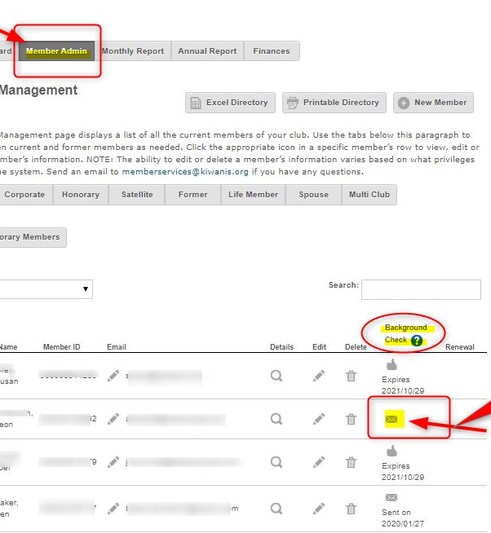
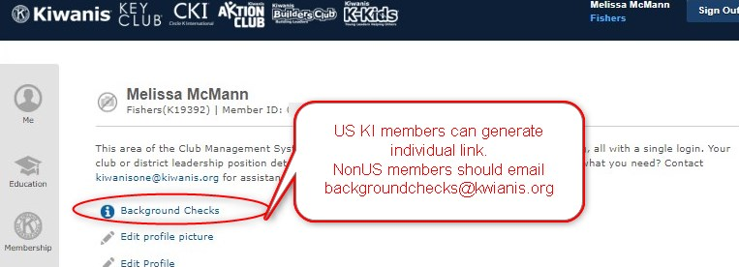
US Club Secretary can generate invitation
Generate background check invitations in Kiwanis Connect
Go to Secretary Dashboard/Member Admin tab
Click on “envelope” icon to send email with individual member’s link to complete background check
US member can click link in Kiwanis Connect

Slide 28
North American SLPs
YP Compliance
As of Sept. 2021 | 9/8/2020 | 10/30/2020 | 12/31/2020 | 4/21/2021 | 6/30/2021 | 9/27/21
All SLPs | 9446 | 9455 | 9460 | 9428 | 8840 | 8091
KI Sponsored SLPs | 8836 | 8804 | 8817 | 8805 | 8405 | 7739
KI Advisors on record | 7174 | 5732 | 5624 | 6027 | 5380 | 5232
KI Advisor background checked | 5292 | 5188 | 4895 | 5181 | 5015 | 4602
Completed annual training | 3149 | 822 | 1274 | 2022 | 2814 | 3180
% Of SLPS sponsored by KI Club | 94% | 93% | 93% | 93% | 95% | 96%
Clubs with KI advisor on record | 81% | 61% | 59% | 64% | 61% | 68%
Advisors with KI Background check | 74% | 91% | 87% | 86% | 93% | 88%
Total % of KI SLPs w BGC Advisor | 60% | 59% | 56% | 59% | 60% | 65%
Annual Training | 44% | 14% | 23% | 34% | 52% | 61%
North American SLPs
YP Compliance

Slide 29
YP Compliance Data as of Sept. 2021
Categories of Data |  | # Number
All SLPs |  | 8091
KI Sponsored SLPs |  | 7739
KI Advisors on record |  | 5232
KI Advisor background checked |  | 4602
Completed annual training |  | 3180
% Of SLPS sponsored by KI Club |  | 96%
Clubs with KI advisor on record |  | 65%
Advisors with KI Background check |  | 88%
Total % of KI SLPs w BGC Advisor |  | 68%
Annual Training |  | 61%
Notes:
Out of the almost 9k SLP clubs, 73% have a valid BGC on file as of June 15th. Our goal is 100% compliance.
*annual training numbers are those KI advisors who take a Policies and Procedures training at the club or district level.

Slide 30
Background Checks & Beyond
Tips for Club Success
Club secretaries should consistently monitor the background check status of their club’s Kiwanis Advisors. This information lives in Kiwanis Connect.
Create a plan to replace Kiwanis Advisors, if needed.
Remind clubs they can budget annually for the $25 expense. This may be taken from either the administrative or service account.

Slide 31

Working Toward the Future
Our goal is to reach & maintain 100% background check compliance for advisors of all Kiwanis Youth Programs.

Slide 32
Creating a Culture of Care

Slide 33

C- Culture of Care
What is Creating a Culture of Care?
Our Culture of Care initiative provides students with the training and resources to be leaders in their school in
  preventing bullying,
  reducing incidences of violence,
  understanding healthy relationships and
  personal boundaries and more.
Notes:
Redwood Group who serves Commercial Property & Casualty insurance to youth-serving organizations
60% of claims are peer to peer v. adult to child- is it more reporting or more incidents?
75% of those claims, children are within 2 yrs of age.
25% are older youth to younger youth.

Slide 34

Culture of Care
Online Training & Resources
Positive Youth & Young Adult development resources
Parent resources on youth development
Adult leader resources on youth & young adult resources
Notes:
Kiwanis Culture of Care initiative encourages advisors and adults to have appropriate interactions with you, create a safe environments and care about age appropriate youth development of our SLP youth members.
“Research has shown that youth who are emotionally insecure, needy, and unsupported may be more vulnerable to the attentions of offenders. (CDC report)

Slide 35
Creating a Culture of Care Certified Champion Students
Key Club Students
FY2020 - 80 students given curriculum & certificates to lead club discussions and activities
Hold Champions check-in meetings
Email campaign
April - workshop held at GATC
July ‘21 – 4 workshops at Summer Leadership Summit
  342 individual virtual attendees (adults & students)
  10 in person attendees
Culture of Care Workshops
Healthy Boundaries – Out of Bounds
You Talking to Me? Effective Peer Communication
Removing Blindfold: Bystander Intervention 101
Training the Trainer
Notes:
Session 1: Out of Bounds: Understanding Healthy Boundaries: Join us as we help students better understand the importance of healthy boundaries. Learn why boundaries are so important and how to successfully implement them in your own life.
Session 2: You Talking to Me? Effective Peer Communication: Can't we all just get along? That question often is on people's minds as they attempt to navigate sometimes challenging interactions or conflicts.
Session 3: Removing the Blindfold: Bystander Intervention 101: Bystander intervention is the act of feeling empowered and equipped with the knowledge and skills to effectively assist in the prevention of violence or harmful situations.
Session 4: Training the Trainer: Train-the-Trainer provides student leaders with competencies that will enable them to effectively facilitate and mentor peers in the Culture of Care curriculum.
Upon completion of these four sessions, each student will receive a certificate and follow-up communication and training throughout the year as you join our Culture of Care.

Slide 36
Creating a Culture of Care
Curriculum & Certification
Circle K International
ICESAHT developing curriculum for students to lead club discussions and activities
April - Feedback session at GATC
July ‘21 - Workshops at ELC
  30 virtual CKI students/189 adults
  5 in-person CKI students/adults
Culture of Care Workshops
Dating & Healthy Relationships
How to Access Resources on Campus
How to be an Upstander
Training the Trainer

Slide 37

Creating a Culture of Care
What’s Next?
Expand Culture of Care to more students
Anti-bullying conversation w/KCI & CKI leaders
Erika’s Lighthouse partnership for Key Club and Builders Club
Active Minds partnership for Circle K International
Notes:
During September’s Suicide Prevention week, CKI is hosting Town Hall on Mental Wellness with Active Minds.
Key club is hosting week long social media posts and activities for students to engage in during Suicide Prevention week.

Slide 38

KI Youth Protection Week
October 11-15, 2021
Encourage clubs to schedule annual YP training prior to volunteering w/SLPs
Policy training webinars
What you need to know about Kiwanis background checks
What you need to know about Praesidium Inc.’s youth protection courses
Hosting District Risk Mgr + YP Mgr seminar

Slide 39


Email inquiries & requests
Kiwanis.org/youthprotection
Backgroundchecks@Kiwanis.org
YouthProtection@Kiwanis.org
CultureofCare@Kiwanis.org

Slide 40

Questions

